Slide 1



"Serious" B2B marketing sup port starting with webinars : Introduction to Majisemi
For those considering Majisemi for the first time
Seminars strong in attracting customers
No.1
Seminars strong in acquiring new business negotiations
No.1
Seminars chosen by IT managers
No.1
Survey by Japan Marketing Research Organization: 2021 service comparison impression survey

Slide 2
Introduction
本日の打ち合わせの目的
はじめて「マジセミ」をご検討される企業のために、以下のような内容についてお話させていただきます。
マーケティングにおける課題のヒアリング
どのようにマジセミをご活用いただくのか？
©2018 MAJISEMI Inc.

Slide 3
Hearing
©2018 MAJISEMI Inc.

Slide 4
Hearing
Issue Identification
■ About the products you want to introduce in the seminar
・Which product or service?
・Intended target audience (who you want to invite to the seminar)?
・Industry, company size, department, position, etc.
※ Majisemi's specialties are "IT, DX, and security departments across all industries, and production/manufacturing departments in factories"
・Competing products?
・Strengths and differentiation points against competing products?
©2018 MAJISEMI Inc.

Slide 5
Hearing
Issue Identification
■ On the necessity of seminars (webinars)
・What is considered important as a means of lead acquisition?
・Seminars (webinars)
・Websites (content marketing)
・リアル展示会
・比較サイト
・GoogleやFacebookなどへの広告
・テレアポ
・その他
■予算の状況
・リード獲得単価、アポ獲得単価
・セミナー（ウェビナー）の予算の有無、及び金額
・上記リード獲得手段の予算の割合
・予算の策定、決定時期
©2018 MAJISEMI Inc.

Slide 6
Hearing
Issue Identification
■セミナー（ウェビナー）の目的／課題
・より多くのリードを獲得したい／集客できない
・ターゲットに合ったリードを獲得したい／リードの質が悪い
・ウェビナーから商談につなげたい／商談につながらない
・ウェビナーの運営を代行してほしい／運営が大変
・まずはスモールスタートでウェビナーをやってみたい
・その他
・ウェビナーを活用した、東南アジアにおける新規顧客開拓やテストマーケティング
©2018 MAJISEMI Inc.

Slide 7
なぜ「ウェビナー」なのか？
©2018 MAJISEMI Inc.

Slide 8
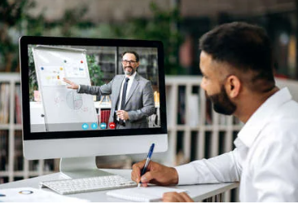

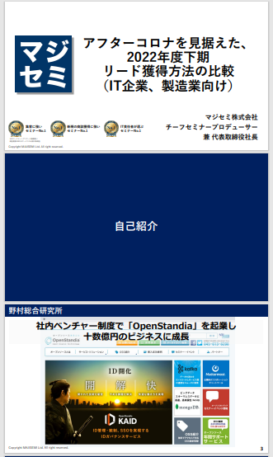
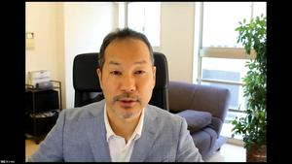
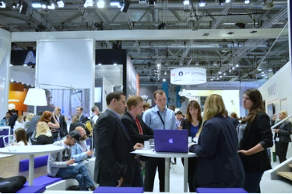
BtoBマーケティングにおけるウェビナーの役割
Webinar
as a Service
Lead acquisition
Lead nurturing
Proposal and order
課題に
気づいてない
課題に気づき
社内で検討
製品・サービスの
候補を捜す
製品・サービスを絞って
評価・選定、稟議
課題に気づかせる
課題について深く理解させ、
解決方法を提示する
競合よりもお客様に早く接触し、課題解決をサポートする
数社～十数者程度の検討の候補に入り、２～３社の最終候補に残る
２～３社の最終候補から自社を選んでもらう
Utilization of webinar content
課題に気づかせる。
課題について深く理解させる。
競合よりもお客様に先に接触し、自社を知ってもらう。
When holding a webinar,
a lot of content is generated
● Presentation materials → White paper
● Presentation video → YouTube, social media
● Presentation content → SEO articles, blog
Webinar
Field sales
Webサイト
Content marketing
Webinar
Social media advertising
Deepen understanding of challenges.
Also provide competitive comparison information and information about our products.
For nurturing existing leads.
リアル展示会
オンラインイベント
Download materials
Field sales
©2018 MAJISEMI Inc.

Slide 9

Email advertising
Positioning of webinars in lead acquisition
planning
Cost per lead
Telemarketing
30,000 JPY
Webinar
リアル展示会
Listing/social media advertising
ビジター
14,500円
Majisemi
Club
10,000 JPY and up
10,000 JPY
Online
Exhibition
(Large-scale webinar)
Comparison site
Download materials
On-demand
Video distribution
5,000 JPY
リアル展示会
Joint exhibition
Low
Interest
High
©2018 MAJISEMI Inc.

Slide 10
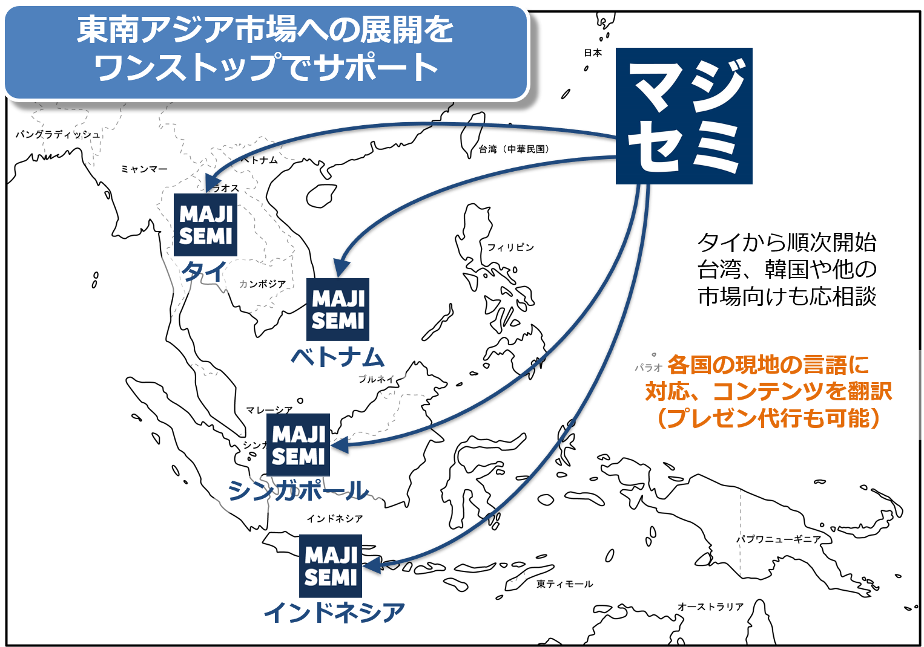
Support for expansion into Southeast Asia using webinars
planning
Webinars can be delivered to Southeast Asia at almost the same price as for Japan.
Your company only needs to prepare a presentation video (plus slides) in Japanese (or English).
Majisemi handles everything from adding local language subtitles, translating slides, to the day of delivery.
Options include post-webinar lead follow-up and secondary use of webinars with local language support.
Promoting joint exhibition at trade shows held in Southeast Asia.
©2018 MAJISEMI Inc.

Slide 11


Why start with webinars?
planning
Cold calls or direct mail without any prior contact can lead to distrust.
First, by holding webinars that "provide valuable information," you can establish initial contact and
gain "trust and credibility."
Features of webinars
When emailing the entire list
Can provide an "interactive experience"
Live Q&A sessions
Demos and factory tours while receiving questions and requests
Can obtain "live feedback"
Pre/post surveys, as well as polls and questions during the presentation
Can attract viewers with "high interest"
In small webinars, participants are those facing challenges your products/services can solve
Build trust by "sharing the space"
Recognized as an "expert"
Building trust through communication such as Q&A
0.7%
70%
Response rate when sending materials via email
is about 100 times!
When emailing seminar participants
Face-to-face communication with customers
can enhance trust and credibility
Response to follow-up afterwards
is approximately 100 times different
*According to our research
©2018 MAJISEMI Inc.

Slide 12
Overview of Majisemi's services
©2018 MAJISEMI Inc.

Slide 13
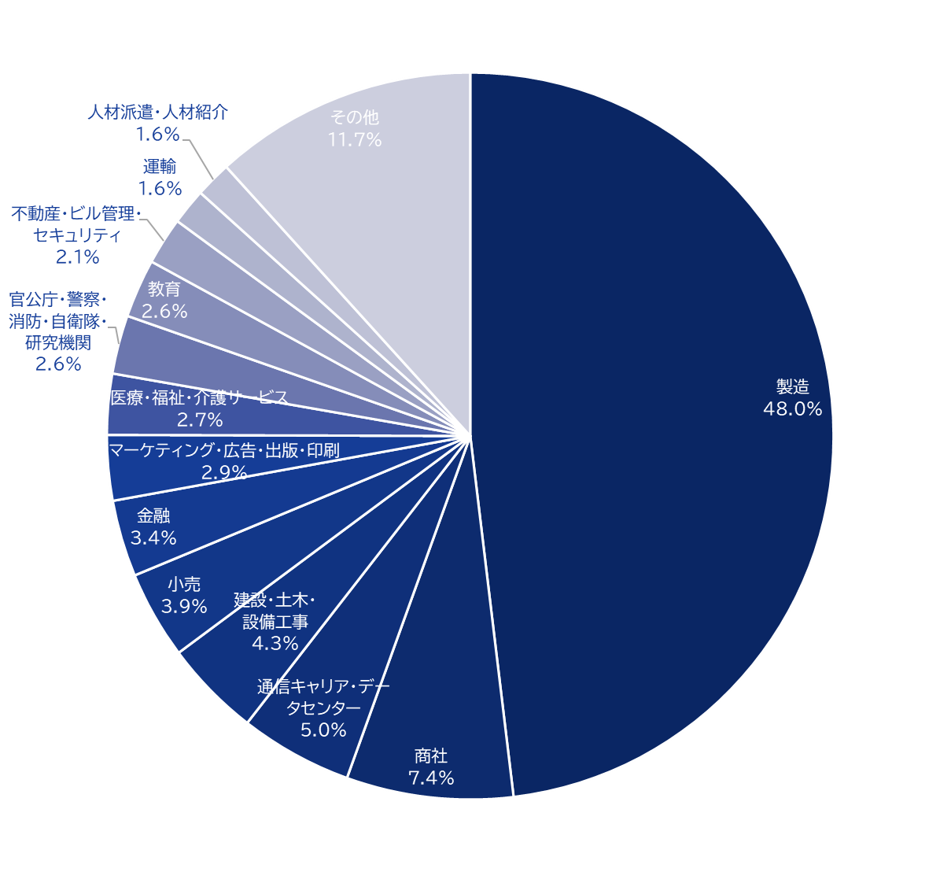
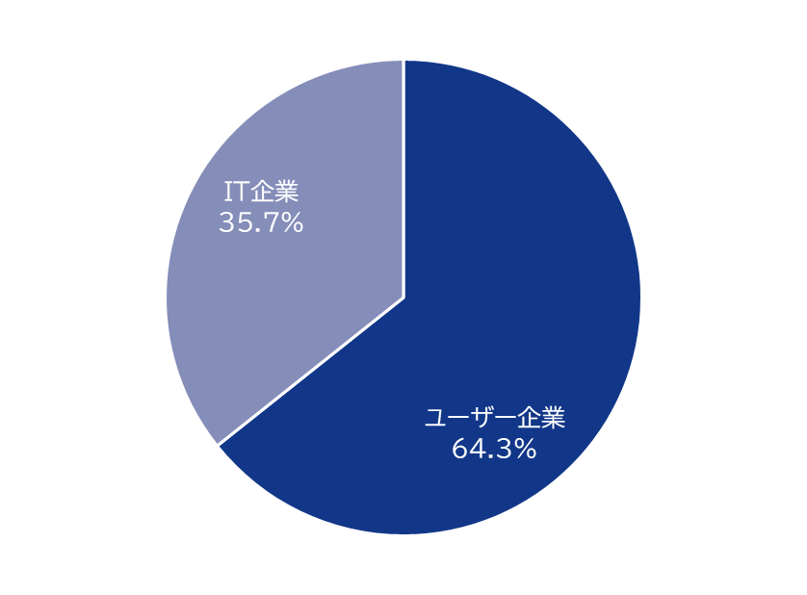
Majisemi's house list
Webinar
as a Service
Customer attraction power
Approximately 250,000
House list owned!
Breakdown of user companies
House
List
Overall
*Estimated from seminar applicants from 2020 to 2024
©2018 MAJISEMI Inc.

Slide 14
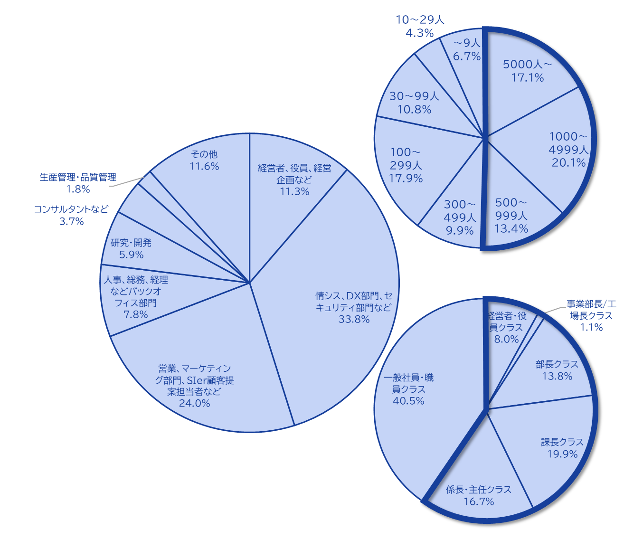
Majisemi's house list
Webinar
as a Service
The Majisemi list is
almost exclusively focused on the following attributes.
Nearly half work at
large enterprises
Company
Size
All industries × Information systems departments, DX-related departments
All industries × Security departments
Manufacturing × Production and manufacturing departments
All industries × Back office departments
IT companies × All job types
Job type
House list breakdown
At Majisemi, to ensure that participants in your webinars are better matched to your products and services, we do not use attribute specification (segmentation) when attracting attendees via email, etc.
Instead, we design the webinar theme (title, announcement text)
on the Majisemi side,
adopting a method to increase the proportion of your target audience.
Emails are not sent to all contacts but prioritized for those highly interested in the set theme.
Position
Primarily managers
©2018 MAJISEMI Inc.

Slide 15





Why is it necessary to host webinars?
Webinar
as a Service
The value of cold leads and the importance of repeating webinars
Lead acquisition
Nurturing and business negotiations
Contract
1 person
Hot leads
3 people
Seminar held
30 people
Cold lead
21 people
Repeat hosting
is important!
27 people
By repeatedly holding webinars, including past participants,
we streamline new lead acquisition and nurturing.
If left unattended
21 people
80% contract with
competitors within 2 years
Majisemi conducts long-term follow-up with past participants,
and also offers 'MajiFollow Plus' to assist in appointment acquisition.
(SiriusDecisions survey)
©2018 MAJISEMI Inc.

Slide 16








Reasons to use Majisemi
Webinar
as a Service
Outsource your webinar management
Repeat PDCA to explore winning patterns
Planning
Attracting attendees
Seminar
Secretariat
Moderation
Appointment acquisition
(Optional)
Survey aggregation
Report creation
SEO article creation
Video production
(Optional)
Review &
Improvement
One-stop service
From start to finish
Majisemi handles it all, so
All support included
with only the cost of attracting attendees!
Focus on the presentation
on the day!
©2018 MAJISEMI Inc.

Slide 17

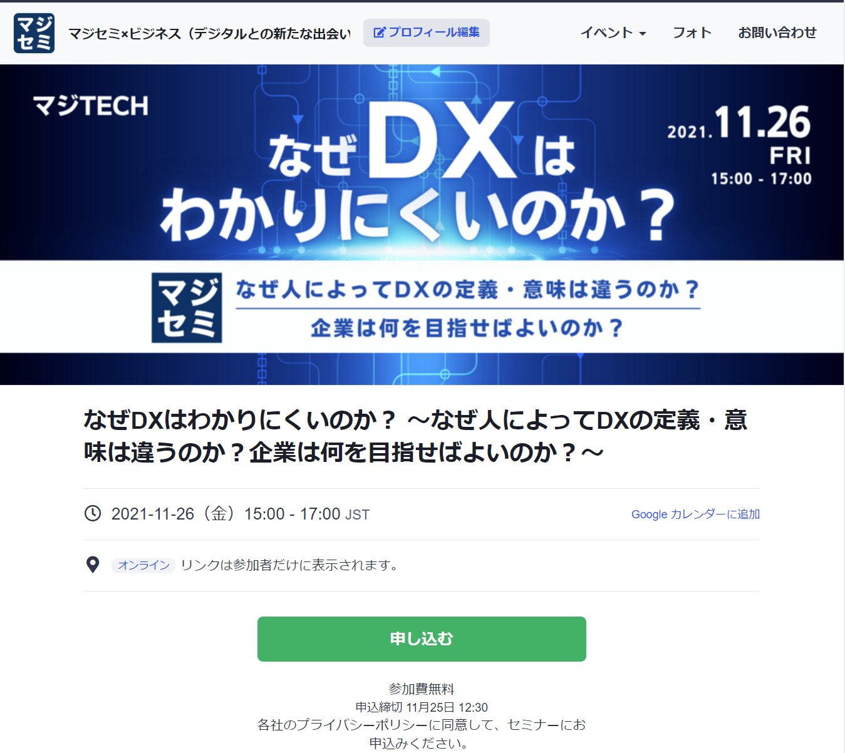
Reasons to use Majisemi
Webinar
as a Service
１回のウェビナーで 新規リード獲得 と、 既存リードのナーチャリング を同時に行うことが可能
Create and publish attendee page
Attracting attendees
マジセミ管理画面
1週間前＆前日リマインド配信
Majisemi attendee slots
マジセミで集客
マジセミ枠
申込者データ
参加用URL配信
企画FIX
貴社集客枠への
お申し込みは
何名でも課金対象外！
貴社がすでにお持ちの
ハウスリストのナーチャリング、
休眠顧客の掘り起こし、
HP等での新規リード獲得に
ぜひご活用ください！
Your attendee slots
After publication
We will provide
the URL
貴社ハウスリスト・HP等でご集客
Your attendee slots
申込者データ
マジセミ集客枠のミラーサイトで、
貴社専用の集客サイトURLを作成致します。
貴社へ全リード納品
©2018 MAJISEMI Inc.
※お断り対象者・キャンセル待ち申込者は除く

Slide 18
ウェビナー成功事例

Slide 19
（事例１）「テーマを変更し、120名以上の集客を実現」＜C社＞
■お客様の課題
・サーバ／インフラ系サービスを中心に販売されている、SIer様
・自社でウェビナーを開催しているが集客できない
・メディアに集客を依頼しても、集客できなかった
■ご利用いただいたプラン
・ビジター（その後、マジセミ倶楽部へ移行）
■マジセミでの対応
・年間1000回のウェビナー開催の中での集客傾向 ノウハウや、 「トレンド分析ツール」な を活用し 、 「集客できる企画」をマジセミ側で立案、ご提案
■結果
・120名以上の集客実現
©2018 MAJISEMI Inc.

Slide 20
（事例2）「テーマを模索しながら50%以上のアポを獲得」＜T社＞
■お客様の課題
・ツールベンダー様
・展示会等中心のマーケティングを実施していたが、商談化に苦戦
■ご利用いただいたプラン
・ビジター（その後、マジセミ倶楽部へ移行）
■マジセミでの対応
・繰り返しウェビナーを開催しながら、「ある程度集客 もでき、かつ、商談につながる テーマ」を模索。
■結果
・毎回30名程度の集客をしつつ、商談化率を10%→20%→50%と改善
・登壇者が自ら、ウェビナー後のフォローを実施
©2018 MAJISEMI Inc.

Slide 21
（事例3）「オンラインに変更し、20%のアポを獲得」＜Z社＞
■お客様の課題
・パッケージ製品・SaaSを開発・販売されているグローバルIT企業
・オフラインセミナーを開催しているが、集客、出席率で苦戦
・商談にもつながらない
■ご利用いただいたプラン
・ビジター
■マジセミでの対応
・オンライン（ウェビナー）のご提案
・「商談につながるセミナー企画」を実施
■結果
・30人申込み→6件アポを実現
©2018 MAJISEMI Inc.
‹#›

Slide 22
（事例4）「フォロー代行で１５％以上のアポを獲得」＜I社＞
■お客様の課題
・自社製品も開発しているインフラ系ITベンチャー企業
・何回かウェビナーを開催し、集客は好調だったが、商談につながらない
・担当者が多忙で、ウェビナー後に十分な営業フォローができていない
■ご利用いただいたプラン
・ビジター
■マジセミでの対応
・「商談につながるセミナー企画」を実施
・ウェビナー終了直後から架電するフォロー代行サービス「マジフォロ」を実施
■結果
・50人申込み→8件アポを実現
©2018 MAJISEMI Inc.

Slide 23
（事例5）「AIがプレゼンし、20%のアポを獲得」＜A社＞
■お客様の課題
・外資系SaaSベンダー
・毎回集客は目標達成しているが、商談につながらない
・講演資料やプレゼン内容にも課題がある
■ご利用いただいたプラン
・マジセミ倶楽部
■マジセミでの対応
・生成AIによる講演原稿作成と、AIデジタルヒューマンによるプレゼン代行を実施
・ウェビナー終了直後から架電するフォロー代行サービス「マジフォロ」を実施
■結果
・20人申込み→4件アポを実現
©2018 MAJISEMI Inc.

Slide 24
プランと料金について
©2018 MAJISEMI Inc.

Slide 25
プランの比較
Pricing Plans
おすすめ
 | ビジター | マジセミ倶楽部 ライト | マジセミ倶楽部 商談保証
こんな方におすすめ！ | ウェビナー開催予定が 1年で1～2回程度 | 年間4回以上ウェビナー開催予定 リード単価を抑えたい | 集客ではなく商談（アポ）を 保証してほしい
リード単価比較 | 14,500円 | 12,000円（毎月10名） 10,000 JPY (for additional audience) | 20,000 JPY (30 people over 3 months) 13,500 JPY (for additional audience)
Not subject to duplicate charges for past applicants *Refer to each plan's description for details | None | Available | Available
Meeting (appointment) guarantee *Refer to each plan's description for details | None | None | Available
Contract period | Per session | Monthly (auto-renewal) | Every 3 months (auto-renewal)
©2018 MAJISEMI Inc.

Slide 26
Are there any services other than the basic plan that interest you?
Service Map
Limited slots
First-come, first-served
Exhibition
Joint exhibition
Your owned leads
(not subject to charges)
Webinar hosting
Lead follow-up, proposal, and order
おすすめ
New service
Presentation script and materials
Creation outsourcing
AI-based presentation outsourcing
Webinar hosting
(Visitor or Majisemi Club)
Follow-up immediatel y after the webinar
(Maji Follow)
Sales outsourcing
(Proposal and order)
(Maji Sales)
Your insi de sales
or fiel d sales
おすすめ
New service
Many companies
Utilized
On-demand
Broadcast
Rebroadcast
2-step
Webinar
Many companies
Utilized
Utilization of webinar content
Many companies
Utilized
Many companies
Utilized
おすすめ
New service
SEO article
Creation
Full video
Provided/free
Full video
Provision/secondary use
Summary
Video production
SEO video creation
©2018 MAJISEMI Inc.

Slide 27
Majisemi Club or visitor?

Slide 28

プランの比較
Pricing Plans
ビジター
Seminar held Attendance record: 30 people
Majisemi Club
Seminar held Attendance record: 30 people
(monthly fee)
10 additional people each month
10 people × @12,000 JPY
Attendance slots
10 people
Use the 20-person free bonus
Attendance slots
20 people
Billing
30 people × 14,500 JPY = 435,000 JPY (excluding tax)
Billing
10 people × 12,000 JPY = 120,000 JPY (excluding tax)

Slide 29
Majisemi Club initial 20-person free bonus
Campaign
By signing up for Majisemi Club, you can use this bonus at your first event.
You can cancel anytime. Even if you cancel after one event, it's more cost-effective than being a visitor.
Image of hosting using special offers
 | January | February | March | April
Membership fee billing amount | 120,000 JPY | 120,000 JPY | 120,000 JPY | 120,000 JPY
Additional attendance slots | +10 people | +10 people | +10 people | +10 people
Campaign-based Additional attendance slots (free) | +20 people | - | - | -
Remaining attendance slots | 30 people | 10 people | 20 people | 30 people
Seminar held | 30 people | - | - | 30 people
Additional audience slots can be purchased anytime
(at a cost-effective 10,000 JPY each),
allowing additional webinars to be hosted
First 20 participants free
Immediately host a webinar for up to 30 participants
Webinar can be hosted
If hosting only once and canceling at the end of March (notification by the end of February),
Only the membership fee of 120,000 JPY × 3 months will be charged.
©2018 MAJISEMI Inc.

Slide 30
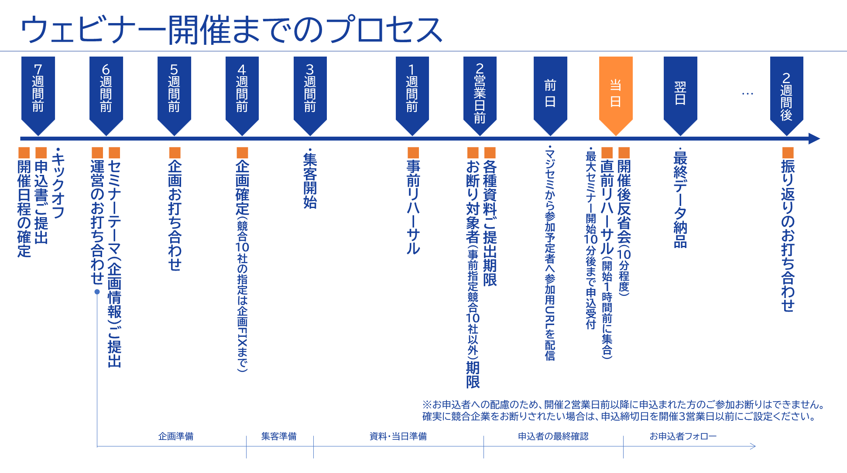
©2018 MAJISEMI Inc.

Slide 31
Take this opportunity to start with Majisemi!
Clients using Majisemi have shared feedback such as
The audience turnout is good,
and it leads to business negotiations.
Awareness increased, and inquiries from the web
also grew.
The staff (attendants and cast) were excellent,
making it easier to host seminars.
and similar comments.
Most client companies repeatedly host seminars with Majisemi.
However, you might have the following concerns.
"Will the target companies really attend?"
"How much easier will the operation become?"
For such customers,
we offer the "Majisemi Club First 20 Participants Free" campaign.
Please try Majisemi!
©2018 MAJISEMI Inc.

Slide 32
~Please check later~
(For your reference) Other information

Slide 33


Reasons to use Majisemi
Webinar
as a Service
Outsource your webinar management
A dedicated planner will create the title and announcement text!
Planning
A Majisemi planner with IT knowledge will collaborate with you to create a webinar plan that achieves audience acquisition and business negotiations.
STEP1
STEP2
STEP3
Formal application
Please enter product name, product information, target, and pain points into the management system.
Planning meeting
Conduct a one-hour online meeting.
Align details based on preliminary information.
企画FIX
Press the approval button in the management system to finalize the plan.
By our company
Preparation for the event page
Preparation for publication has
started!!
By email
Confirmation
Attendants (seminar secretariat) will support you until the webinar is hosted!
Attendant
(seminar secretariat)
Attendants with experience in managing 1,000 seminars annually will accompany you until the seminar is hosted.
Feel free to consult us with any issues!
STEP4
STEP 5
STEP6
On the day
・Moderation
・Collect surveys
Event page publication
Create application page
Handle applicants
・Respond to inquiri es ・Send reminders
・Issue participation URL
Rehearsal
・Confirm the day's flow and requests ・Check the speaker's connection env ironment ・Confirm preparation status
Report creation
Cast
Cast
©2018 MAJISEMI Inc.

Slide 34
Reasons to use Majisemi
Webinar
as a Service
Dedicated support from the planning stage
Planning stage flow
Preliminary preparation
The planning manager will gather information on the seminar theme you share in advance and create promotional angle proposals.
Planning meeting
Conduct a meeting for about one hour. Propose promotional angles and align details.
Create planning proposal
Based on the details aligned in the meeting, the planning manager will draft the title and announcement text.
Submit planning proposal
After creating the proposal, the planning manager will submit it via email.
Confirm planning content
Please review the planning proposal and share any feedback you may have.
Finalize planning
Once the content review and feedback revisions are complete, press the approval button in the management system to finalize the plan.
Preparation for the event page
Start preparation for publication
©2018 MAJISEMI Inc.

Slide 35
Event flow
On the day of the event
Webinar
as a Service
Event time
Distribution tools
Typical seminar flow
Choose from 5 slots
(Weekdays only *No events on weekends or holidays)
1 hour per seminar is the standard
You can choose from 2 types
* We recommend Zoom for its features and streaming quality
* For seminars hosted by Majisemi, an extension fee applies for events longer than 1 hour (150,000 JPY/hour)
10:00-11:00
Registration starts
15 minutes
11:00-12:00
Opening
(Majisemi cast)
Zoom
Teams
13:00-14:00
5 minutes
Presentation
14:00-15:00
30-40 minutes
Poll
3:00 PM - 4:00 PM
Q&A
(Navigated by Majisemi cast)
* On Mondays, only the 2:00 PM and 3:00 PM sessions are available
* Majifolo is only conducted at the 10:00 AM and 11:00 AM sessions
* Seminars targeting the manufacturing industry are scheduled at 11:00 AM and 1:00 PM to avoid theme overlap
10-15 minutes
End
©2018 MAJISEMI Inc.

Slide 36
Reasons to use Majisemi
Webinar
as a Service
Effective use of content
Branding & new lead acquisition
Create articles from presentation content
Register on your website, also for SEO measures
SEO article
Create (blog)
When hosting a webinar
Reuse content to
Continue lead nurturi ng and new lead acqui sition after hosting
Distributed later exclusively to absentees
Rebroadcast past Majisemi event videos
Effortless hosting without live presentation
Webinar hosting
Missed session streaming
Rebroadcast
Recorded video
Upload to your website or YouTube
Summary vid eo creation
On your website or
Post on your company-operated SNS
Webinars or videos other than Majisemi
Secondary use on portals and advertising media
Full vide o provided/free*
Full video p rovided/secondary use*
Lead nurturing
Posted on majisemi.com
Acquire new leads
Majisemi Club benefits
*In the trial, we do not provide full videos, whether free or paid. However, a fter the main contract, past sessions can be provided regardless of the plan.
Majilead
Material download
©2018 MAJISEMI Inc.

Slide 37
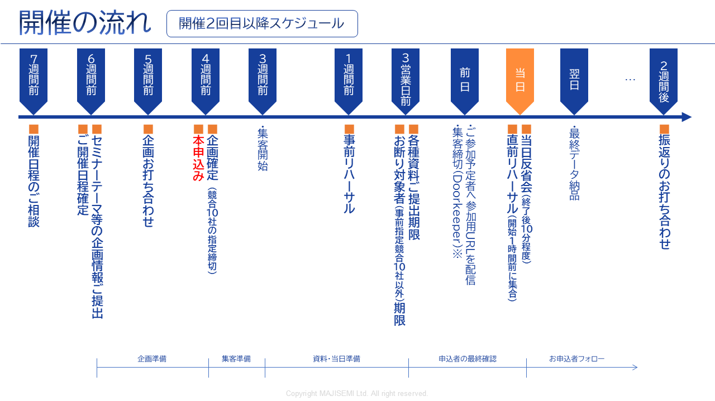
Webinar
as a Service
*To accommodate applicants, we cannot refuse participation for those who apply within 2 business days before the event.
If you want to ensure competitors are excluded, set the application deadline 3 business days prior.
©2018-2024 MAJISEMI Inc.
©2018 MAJISEMI Inc.

Slide 38
Basic plan
Majisemi Visitor
Plan details
Reference plan
Pricing Plans
A fully performance-based plan for hosting a one-time webinar.
Choose from 4 types depending on how much you want to delegate.
We accept applications from 20 people.
If there are only 10 applications, billing will be for 10 people only.
14,500 JPY per application (excluding tax)
・ Host and apply each time
・ Performance-based billing according to the number of attendees
・ Applications from 20 or more people
(Billing is only for the number of attendees)
*To accurately track the number of attendees, we will prepare the application page and provide the list to your company.
*Actual billing will be based on the number of applicants up to the maximum number above. If capacity is reached, application acceptance will stop.
*For privacy protection, the list will be delivered directly to the seminar organizer.
*Billing includes not only participants but also absentees (cancellations before or on the day).
*We will strive to attract as many attendees as possible, but attendance is not guaranteed.
*Due to the seminar theme or other concurrent events, there may be cases where no attendees are attracted.
Management
Management
Menu |  | Planning | Attracting attendees LP setup | Moderator | Other media Import | URL delivery Reminder | Zoom Provision | Post-event Survey
Majisemi ビジター | Standard | ○ | ○ | ○ | No other media posting | ○ | ○ | ○
 | Planning & customer acquisition | ○ | ○ | - |  | - | - | -
 | Customer acquisition & management | - | ○ | ○ | - | ○ | ○ | ○
 | Customer acquisition only | - | ○ | - | - | - | - | -
Product name | Description | Quantity | Unit price (¥) | Amount (¥)
Majisemi Visitor (20 people) | Webinar Planning, attracting attendees, and management | 20 | 14,500 | 290,000
Visitor plan Reference plan for 20 people |  | Subtotal |  | 290,000
 |  | Consumption tax (10%) |  | 29,000
 |  | Total (including tax) |  | 319,000
©2018 MAJISEMI Inc.

Slide 39
Basic plan
マジセミ倶楽部 ライト
Plan details
Reference plan
Pricing Plans
Monthly fee 120,000 JPY (excluding tax) *Light plan includes 10 customer acquisition slots
Additional customer acquisition slots @10,000 JPY (excluding tax)
Automatic renewal every month
Add 10 customer acquisition slots each month
Minimum webinar capacity is 30 people
If hosting a webinar with 30 participants in the first month, purchase an additional 20 participant slots (@10,000 JPY each)
If the number of participants does not meet the target, the remaining slots can be carried over to the following months
Additional participant slots can be purchased for @10,000 JPY
If someone who has registered for at least one of your company's last three paid seminars registers again for this seminar, they will not be charged for this seminar (fan development)
Other benefits include providing leads from those who download publicly available presentation materials, a branding dashboard, and a trend analysis tool
Majisemi Club is a membership service that continuously holds webinars, applying the PDCA cycle to create better webinars. Membership is subject to screening.
For Majisemi Club, we offer a one-stop service including planning, customer acquisition, moderation, and management. We cannot support customer acquisition only.
Furthermore, the seminar content (planning) will be a "problem-solving seminar" rather than a "product introduction." Product introductions will be conducted in the latter part of the presentation. The seminar content will be decided in consultation with the Majisemi planning team. It may not be possible to hold a seminar on your desired theme. If you wish to decide the theme yourself, please use the visitor plan.
Please note that considering the purpose of the aforementioned Majisemi Club, a penalty will be set for cancellations within one year of the contract start. (We will charge the difference from the visitor fee)
*To accurately track the number of attendees, we will prepare the application page and provide the list to your company.
※ If the capacity is reached, we will stop accepting applications.
*For privacy protection, the list will be delivered directly to the seminar organizer.
※ Not only participants but also absentees (pre-cancellations, same-day cancellations) are counted towards the number of attendees.
※ The contract is automatically renewed monthly and will continue in the same manner.
※ Upon withdrawal, refunds for unused customer acquisition slots cannot be made. Additionally, you cannot rejoin Majisemi Club for one year after withdrawal.
※ Please notify us by email by the end of the month prior to the withdrawal month.
※ Benefits are subject to change.
If you have challenges with converting seminars into business discussions or want to strengthen your website content and SEO, please consider our value set plans mentioned later.
Product name | Description | Category | Amount (¥)
Majisemi Club Light (30 participants) | Webinar planning, attracting participants, and management | Monthly fee | 120,000
Majisemi Club Light Plan 30 participants attracted, 10 participants through the monthly fee, 20 through additional slots |  | Additional participant slots | 200,000
 |  | Consumption tax (10%) | 32,000
 |  | Total (including tax) | 352,000
©2018 MAJISEMI Inc.

Slide 40
Basic plan
マジセミ倶楽部 ライト
billing pattern
Pricing Plans
Example of webinar hosting and billing with Majisemi Club
add 10 attendees each month
Webinar
Held
Webinar
Held
Webinar
Held
seminars can be held anytime (or not at all)
(target capacity is 30 or more, rebroadcasts are 10 or more)
Webinar
Held
 | January | February | March | April | May | June | July | August | September | October | November
Additional attendance slots | +10 | +10 | +10 | +10 | +10 | +10 | +10 | +10 | +10 | +10 | +10
Beginning of the month Remaining attendance slots | 10 | 10 | 20 | 30 | 15 | 10 | 20 | 30 | 40 | 50 | 10
Monthly fee billing | 120,000 JPY | 120,000 JPY | 120,000 JPY | 120,000 JPY | 120,000 JPY | 120,000 JPY | 120,000 JPY | 120,000 JPY | 120,000 JPY | 120,000 JPY | 120,000 JPY
Seminar held Target capacity | 30 people |  |  | 30 people | 50 participants |  |  |  |  | 50 participants
Seminar held Actual participants | 30 people |  |  | 25 participants | 48 participants |  |  |  |  | 50 participants
consumption of attendee slots | -10 |  |  | -25 | -15 |  |  |  |  | -50
end of the month Remaining attendance slots | 0 | 10 | 20 | 5 | 0 | 10 | 20 | 30 | 40 | 0 | 10
Additional participant slots | 20 |  |  |  | 33
Additional participant slots billing | 200,000 JPY |  |  |  | 330,000 JPY
target capacity is 30 or more
events with 50, 100 participants, etc. are OK
seminars with 30 participants from the first month are OK
carry over any shortfall to the next month
any shortfall will be billed at 10,000 JPY each
there will be no more attendees than the target capacity
©2018 MAJISEMI Inc.

Slide 41

Basic plan
マジセミ倶楽部 商談保証
Plan details
Reference plan
Pricing Plans
600,000 JPY every 3 months (excluding tax)
Contract automatically renews every 3 months
Guarantee of 30 attendees and 3 business meetings every 3 months
Majifolo is provided for free
If targets are not met, the shortfall will be carried over to future seminars
For additional events with more than 31 participants, each registration is 13,500 JPY
If someone who has registered for at least one of your company's last three paid seminars registers again for this seminar, they will not be charged for this seminar (fan development)
Other benefits include providing leads from those who download publicly available presentation materials, a branding dashboard, and a trend analysis tool
This is a plan that automatically renews every 3 months. We guarantee 30 attendees and 3 business meetings (appointments).
Our company will handle seminar content planning, attracting attendees, day-of operations, and sending materials to participants.
Majifolo is included in the fee.
If the initial seminar does not meet 30 participants and 3 appointments, it will be carried over to that quarter or the next quarter,
Additional seminars will be held. (The goal is to achieve this initially)
*To accurately track the number of attendees, we will prepare the registration page and provide the list to your company.
*If capacity is reached, registration will be stopped.
*For privacy protection, the list will be delivered directly to the seminar organizer.
※ Not only participants but also absentees (pre-cancellations, same-day cancellations) are counted towards the number of attendees.
*Contracts are automatically renewed every 3 months and will continue in the same manner.
※ Upon withdrawal, refunds for unused customer acquisition slots cannot be made. Additionally, you cannot rejoin Majisemi Club for one year after withdrawal.
*To withdraw, please notify us by email by the end of the month prior to the withdrawal month.
*We may not be able to accommodate requests for guaranteed business meetings.
※ Benefits are subject to change.
Product name | Description | Quantity | Unit price (¥) | Amount (¥)
Majisemi Club event (30 participants) | Webinar planning, attracting participants, and management | 1 | 600,000 | 600,000
Majifolo (30 participants) | Appointment setting via phone and email for participants | 30 | 3,500 | 105,000
 | All cases are free under the Majisemi Club business meeting guarantee | 30 | -3,500 | -105,000
Majisemi Club Business Meeting Guarantee Plan Reference plan for 30 participants |  | Subtotal |  | 600,000
 |  | Consumption tax (10%) |  | 60,000
 |  | Total (including tax) |  | 660,000
Guaranteed attendee acquisition and business meetings!
©2018-2023 MAJISEMI Inc.

Slide 42
Majisemi Club's Value Plans (Revision Planned)
Pricing Plans
おすすめ
 |  | Light | Silver | Gold | Platinum | Premium
Included Services | Webinar hosting | ● | ● | ● | ● | ●
 | SEO article creation | ― | ●※1 | ― | ― | ●※1
 | Majifollow | ― | ― | ●※2 | ●※2 | ●※2
 | Majifollow Plus | ― | ― | ― | ●※3 | ●※3
 | Summary Video | ― | ― | ― | ― | ●※1
Additional Audience Slot Gift (Bonus)※4 |  | ― | 10 people annually Equivalent to 100,000 JPY | 20 people annually Equivalent to 200,000 JPY | 40 people annually Equivalent to 400,000 JPY | 80 people annually Equivalent to 800,000 JPY
Monthly fee |  | 120,000 JPY | 135,000 JPY | 155,000 JPY | 255,000 JPY | 385,000 JPY
Simple Webinar
Only want to request hosting
Want to utilize presentation content
on the website
Want to follow up
immediately after the webinar
Want to reliably
connect webinars to business negotiations
Want to maximize
the effectiveness of webinars
※1 SEO article creation and summary video creation can be conducted up to 4 times a year. Additional options can be purchased for more.
※2 Majifollow can be conducted for up to 120 people annually. Additional options can be purchased for more.
※3 Includes monthly activity costs for Majifollow Plus. A success fee of 30,000 JPY per appointment is charged separately.
※4 The additional audience slot gift bonus is granted one year after joining Majisemi Club and annually in the same month thereafter.
(All amounts are tax-exclusive)
©2018 MAJISEMI Inc.

Slide 43
Other options *Please consult with us for details
Webinar
as a Service
Name | Price (excluding tax) | Description
Majifollow (Post-seminar follow-up) | @3,500 JPY x number of attendees | Majisemi's follow-up specialists will contact participants and absentees via email and phone immediately after the seminar.
SEO article creation | 50,000 JPY | We will create an article of approximately 3,000 characters with SEO in mind based on the seminar content. By publishing it on your website, you can promote content marketing.
Full video provision/paid | 200,000 JPY | This option provides the seminar video for secondary use. *Free provision within certain usage limits. No provision during trial, whether paid or free.
Summary video creation | 50,000 JPY | When posting seminar videos on YouTube, long videos tend to be disliked. Therefore, we will edit and provide a 5-10 minute version.
Missed session streaming | 50,000 JPY | For those who registered but were absent on the day, we will allow them to view the day's video.
Rebroadcast | @14,500 JPY/10,000 JPY | Host additional webinars effortlessly using recordings from past Majisemi events.
Two-step webinar | 200,000 JPY | We will plan and host a theme that leads to more business discussions (appointments) for those who previously registered for your webinars (your prospective clients), such as competitor comparisons, product introductions, and demos.
Operational support (operation outsourcing) | 200,000 JPY | We will manage the operation of your seminar. This includes creating the registration page, managing registrants, providing Zoom, and moderating on the day. (Attracting attendees is not included. You will need to handle that.)
Presentation by Majisemi representative Terada Presentation at your seminar | 300,000 JPY and up *Approximately 30 minutes to 1 hour | Majisemi representative Terada will facilitate presentations, discussions, or panel discussions at your seminar. Please consult on the theme.
Keynote speech by 'Evangelist AI' Digital Terada | 100,000 JPY | 'Evangelist AI' Digital Terada, utilizing generative AI, will deliver a keynote speech at your webinar. - You will give a seminar presentation but lack time to create the script and slides - You don't have skilled presenters (or they are busy), so you want the presentation to be outsourced
SEO video creation | 50,000 JPY per video and up *In units of 10, excluding initial costs | This is a strategy to aim for top rankings in YouTube and Google video searches. Majisemi will create a custom AI avatar for your company and produce video content explaining terms. Scripts will also be delivered, and blog use is possible.
Product comparison video creation | 500,000 JPY and up *Excluding initial costs | We will create a competitive product comparison video to strongly highlight the strengths of your product. Majisemi will create a custom AI avatar for your company and produce product comparison video content. Distribution via webinar is also possible.
©2018 MAJISEMI Inc.

Slide 44
Notes
Webinar
as a Service
■ Generally, meetings start 6 weeks in advance, and the formal application is made 4 weeks before the event.
Additional charges
Cancellation fees
For all services, if you cancel after making a 'formal application' through Majikan (Majisemi management screen) or after we receive your order form/application form, a 100% cancellation fee will apply.
However, for webinar events, the cancellation fee is capped at 20 attendees for visitors and 30 attendees for Majisemi Club.
For Majifolo, the cancellation fee is capped at 20 attendees for visitors and 30 attendees for Majisemi Club.
If adjustments to the title, announcement text, etc., are delayed and the webinar cannot be published by 5 PM, 10 business days before the event date, it will be treated as a cancellation and the above cancellation fees will be charged.
No refunds will be given for remaining attendee slots upon withdrawal from Majisemi Club.
Considering the purpose of Majisemi Club, a penalty is set for cancellations within one year of the contract start. Please understand. (The difference from the visitor fee will be charged.)
Majisemi Visitor
Orders placed less than 4 weeks before the event will incur a surcharge.
 | Unit price (excluding tax) | Maximum specification
Basic fee (Orders placed more than 4 weeks before the event) | 14,500円 | 20 or more attendees
Orders placed less than 4 weeks before the event | ×1.25 surcharge
Orders placed less than 3 weeks before the event | ×2 surcharge
Various Majisemi Club
If the formal application cannot be completed 4 weeks before the event, there is no surcharge, but the event will be postponed upon consultation.
©2018 MAJISEMI Inc.

Slide 45
Majisemi Inc.

Slide 46

Company name
Headquarters location
Representative name
Business activities
Seminar hosting achievements
Established
Capital
Number of employees
Majisemi Inc.
3rd Floor, Shiodome Building, 1-2-20 Kaiga n, Minato-ku, Tokyo 105-0022 Yuichi Terada
Operation of the IT and manufacturing industry specialized seminar marketing service 'Majisemi'
Last year's achievements: approximately 1,000 events held, total attendance approximately 60,000 people (2023)
January 2018
10 million JPY
45 employees
About Us
Company overview
Creating new encounters and experiences with digital-rel ated products and services to promote the development of domestic industries and the advancement of engineers.
To achieve this, we convey the potential and excellence of technology to society, regardless of the size of the providing company.
We clearly communicate to end-users not the technology itself, but how it can solve their problems.
By 2025, we aim to host 2,000 webinars annually.
MISSION
セミナーをエンタメに変える
セミナーで社会を変える
おかげ様で３つのNo.１
獲得しました！1
集客に強いセミナーNo.1
IT責任者が
選ぶセミナー
No.1
新規の商談獲得に
強いセミナー
No.1
©2018 MAJISEMI Inc.
日本マーケティングリサーチ機構調べ調査概要:2021年サービスの比較印象調査

Slide 47
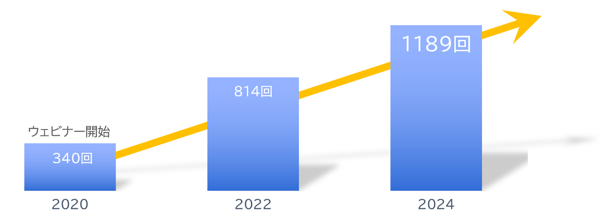
About Us
With clients
Number of seminars held
Increasing every year!
A10ネットワークス株式会社
アイテック阪急阪神株式会社
アドバンテック株式会社
株式会社アクシオ
株式会社アシスト
伊藤忠テクノソリューションズ株式会社
株式会社インターネットイニシアティブ
インフォコム株式会社
エクイニクス・ジャパン株式会社
SCSK株式会社
エフセキュア株式会社
エムオーテックス株式会社
エンカレッジ・テクノロジ株式会社
エントラストジャパン株式会社
株式会社オージス総研
株式会社オプロ
クリックテック・ジャパン株式会社
クロス・ヘッド株式会社
KCCSモバイルエンジニアリング株式会社
株式会社サーバーワークス
サイオステクノロジー株式会社
サイバートラスト株式会社
株式会社ジール
CTCシステムマネジメント株式会社
株式会社システナ
シンガポールテレコム・ジャパン株式会社
GMOグローバルサイン株式会社
JBサービス株式会社
スターティアレイズ株式会社
Smart Style Co., Ltd.
Sumitomo Electric Information Systems Co., Ltd.
Zoho Japan Corporation
Soliton Systems K.K.
Dynatrace
TIS Inc.
Techvan Co., Ltd.
TechMatrix Corporation
Delivery Consulting Inc.
Dell EMC
NSW Inc.
Hulinks Inc.
Netskope Japan Co., Ltd.
Pasona Tech, Inc.
Nippon Telegraph and Telephone East Corporation
Fujitsu Limited
Fujitsu Communication Services Limited
Fuji Electric IT Solutions Co., Ltd.
Mitsubishi Electric Information Systems Corporation
Mirantis Japan K.K.
Monstar Lab, Inc.
Red Team Technologies Inc.
Rosetta Corporation
(Agency)
MM Research Institute Ltd.
Creative Bank Inc.
Target Media Co., Ltd.
Nikkei Advertising Inc.
Bigbeat Inc.
Mynavi Corporation
取引実績
Major clients only, in alphabetical order
©2018 MAJISEMI Inc.

Slide 48
集客に強いセミナーNo.1
No.1 seminar for acquiring new business negotiations
No.1 seminar chosen by IT managers
Survey by Japan Marketing Research Organization: 2021 service comparison impression survey
セミナーをエンタメに変える
セミナーで社会を変える

